Slide 1

Virtual University
Human-Computer Interaction
Lecture 15
Interaction Paradigms
Imran Hussain
University of Management and Technology (UMT)
Notes:
1

Slide 2
In the Last Lecture
Interaction
  Models of Interactionn
Ergonomics
  physical aspects of interfaces
  industrial interfaces
Common Interaction Styles
  command line interface
  menus
  natural language
  question/answer and query dialogue
  form-fills and spreadsheets
Notes:
2

Slide 3
In Today’s Lecture
Elements of WIMP interfaces
What are Paradigms
Paradigms of Interaction
Paradigm shifts (example)
  Batch processing
  Timesharing
  Networking
  Graphical display
  Microprocessor
  WWW
  Ubiquitous Computing
Notes:
1

Slide 4
Elements of the WIMP Interface
windows, icons, menus, pointers
buttons, toolbars,
palettes, dialog boxes

Slide 5
Windows
Areas of the screen that behave as if they were independent
  can contain text or graphics
  can be moved or resized
  can overlap and obscure each other, or can be laid out next to one another (tiled)

Slide 6
Windows
scrollbars
title bars

Slide 7
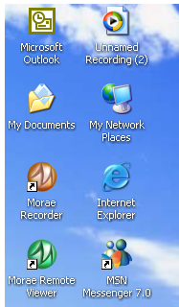


Icons
small picture or image
represents some object in the interface
  often a window or action
windows can be closed down (iconised)
  small representation ﬁ many accessible windows
icons can be many and various
  highly stylized
  realistic representations.

Slide 8
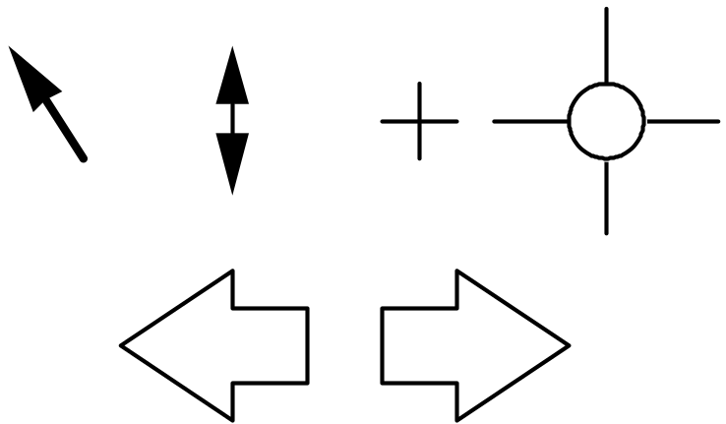
Pointers
important component
  WIMP style relies on pointing and selecting things
uses mouse, trackpad, joystick, trackball, cursor keys or keyboard shortcuts
wide variety of graphical images

Slide 9
Menus
Choice of operations or services offered on the screen
Required option selected with pointer

Slide 10
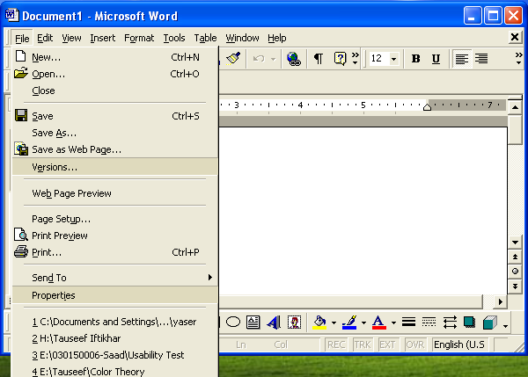
Menus
problem – take a lot of screen space
solution – pop-up: menu appears when needed

Slide 11
Kinds of Menus
Menu Bar at top of screen (normally), menu drags down
  pull-down menu - mouse hold and drag down menu
  drop-down menu - mouse click reveals menu
  fall-down menus - mouse just moves over bar!
Contextual menu appears where you are
  pop-up menus - actions for selected object
  pie menus - arranged in a circle
    easier to select item (larger target area)
    quicker (same distance to any option)
    … but not widely used!

Slide 12
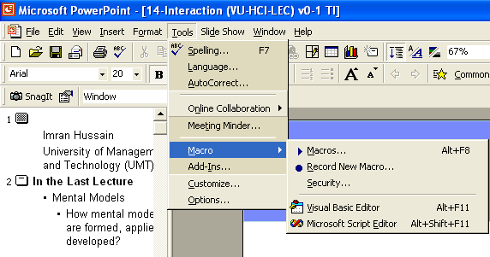
Pull-down Menu

Slide 13
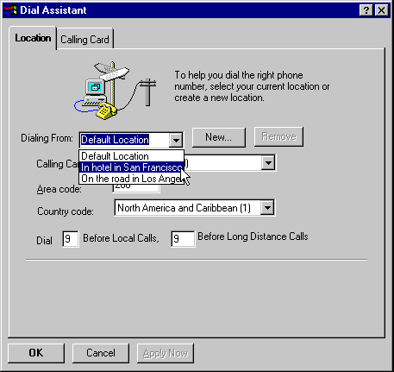
Drop-down Menu

Slide 14
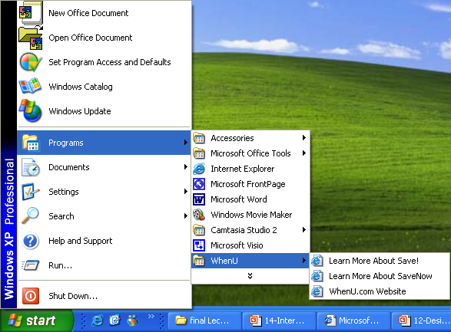
Fall-down Menus

Slide 15
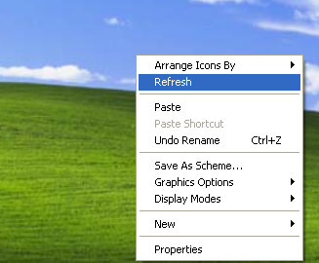
Pop-up Menus

Slide 16
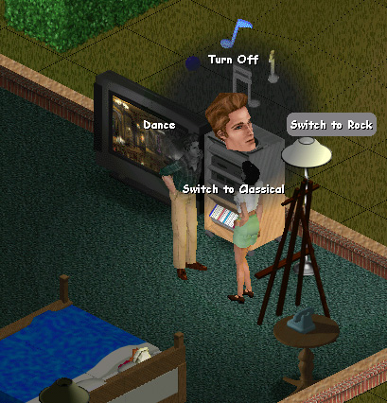
Pie Menu

Slide 17
Menus Extras
Cascading menus
  hierarchical menu structure
  menu selection opens new menu
  and so in ad infinitum
Keyboard accelerators
  key combinations - same effect as menu item
  two kinds
    active when menu open – usually first letter
    active when menu closed – usually Ctrl + letter
  usually different

Slide 18
Keyboard Accelerators
Alt
+
T

Slide 19
Menus Design Issues
which kind to use
what to include in menus at all
words to use (action or description)
how to group items
choice of keyboard accelerators

Slide 20
Buttons
individual and isolated regions within a display that can be selected to invoke an action
Special kinds
  radio buttons
  – set of mutually exclusive choices
  check boxes
  – set of non-exclusive choices

Slide 21
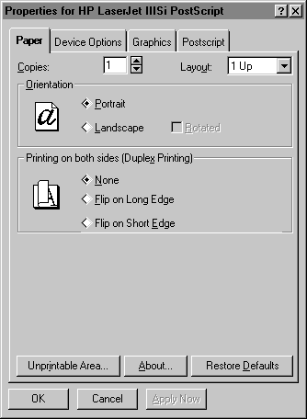
Radio Buttons

Slide 22
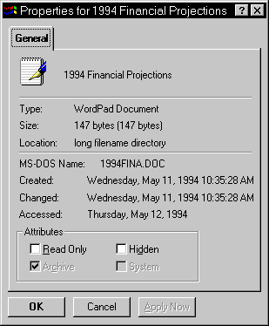
Check Boxes

Slide 23
Toolbars
long lines of icons …
… but what do they do?
fast access to common actions
often customizable:
  choose which toolbars to see
  choose what options are on it

Slide 24
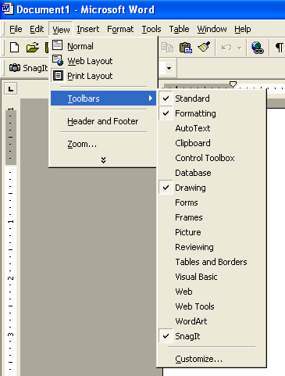
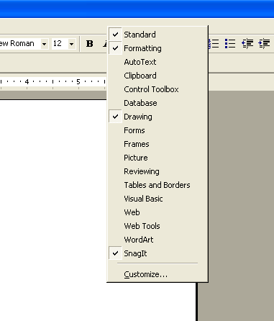
Customization

Slide 25
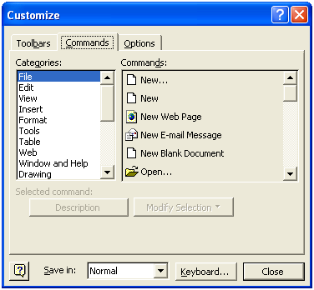
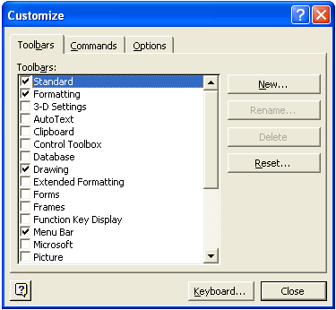
Customization

Slide 26
Palettes and Tear-off Menus
Problem
menu not there when you want it
Solution
palettes – little windows of actions
  shown/hidden via menu option
  e.g. available shapes in drawing package
tear-off and pin-up menus
  menu ‘tears off’ to become palette

Slide 27
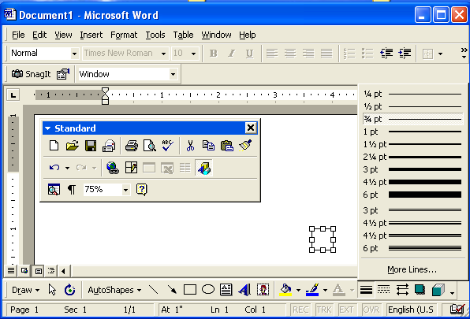
Palettes and Tear-off Menus

Slide 28
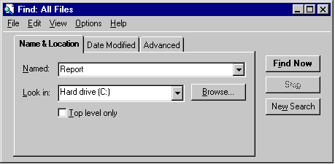
Dialogue Boxes
information windows that pop up to inform of an important event or request information.

Slide 29
Why Study Paradigms?
Concerns
  how can an interactive system be developed to ensure its usability?
  how can the usability of an interactive system be demonstrated or measured?
History of interactive system design provides paradigms for usable designs

Slide 30
What are Paradigms
Predominant theoretical frameworks or scientific world views
  e.g., Aristotelian, Newtonian, Einsteinian (relativistic) paradigms in physics
Understanding HCI history is largely about understanding a series of paradigm shifts
  Not all listed here are necessarily “paradigm” shifts, but are at least candidates
  History will judge which are true shifts

Slide 31
Interaction Paradigms
Informs design of a conceptual model
A particular philosophy or way of thinking about interaction design
  E.g., designing applications for the desktop environment

Slide 32
Paradigms of Interaction
New computing technologies arrive, creating a new perception of the
human—computer relationship.
We can trace some of these shifts in the history of interactive technologies.

Slide 33

The Initial Paradigm
Batch processing
Impersonal computing

Slide 34
Example Paradigm Shifts
Batch processing
Time-sharing
Interactive computing

Slide 35
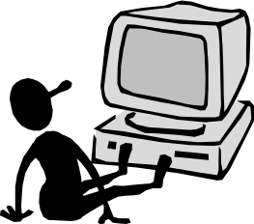
Example Paradigm Shifts
Batch processing
Timesharing
Networking
@#$% !
Community computing

Slide 36
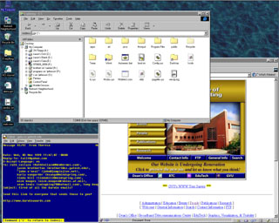
Example Paradigm Shifts
Batch processing
Timesharing
Networking
Graphical displays
Move this file here,
and copy this to there.
C…P… filename
dot star… or was
it R…M?
% foo.bar
ABORT
dumby!!!
Direct manipulation

Slide 37
Example Paradigm Shifts
Batch processing
Timesharing
Networking
Graphical display
Microprocessor
Personal computing

Slide 38
Example Paradigm Shifts
Batch processing
Timesharing
Networking
Graphical display
Microprocessor
WWW
Global information

Slide 39

Example Paradigm Shifts
Batch processing
Timesharing
Networking
Graphical display
Microprocessor
WWW
Ubiquitous Computing
A symbiosis of physical and electronic worlds in service of everyday activities.

Slide 40
“Where are We Now?”
?
WIMP
(Windows)
User Productivity
Command Line
Batch
1940s – 1950s
1960s – 1970s
1980s - Present
?
Time

Slide 41
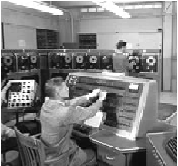
Time-sharing
1940s and 1950s – explosive technological growth
1960s – need to channel the power
J.C.R. Licklider at ARPA
single computer supporting multiple users

Slide 42
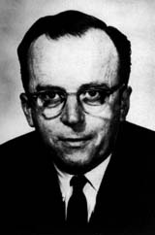
Innovator: J. R. Licklider
1960 - Postulated “man-computer symbiosis”
Couple human brains
and computing machines
tightly to revolutionize
information handling

Slide 43
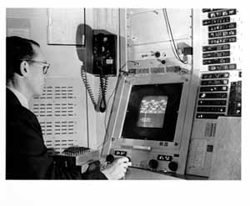
Video Display Units
more suitable medium than paper
1962 – Sutherland's Sketchpad
computers for visualizing and manipulating data
one person's contribution could drastically change the history of computing
Ivan Sutherland
Sketchpad - ‘63 PhD thesis at MIT
  Hierarchy - pictures & sub pictures
  Master picture with instances (i.e., OOP)
  Constraints
  Icons
  Copying
  Light pen as input device
  Recursive operations

Slide 44
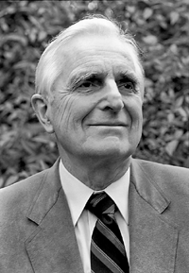
Programming toolkits
Engelbart at Stanford Research Institute
1963 – augmenting man's intellect
1968 NLS/Augment system demonstration
the right programming toolkit provides building blocks to producing complex interactive systems
Douglas Englebart
Inventor
of mouse

Slide 45

About Doug Engelbart
Graduate of Berkeley (EE '55)
  "bi-stable gaseous plasma digital devices"
Stanford Research Institute (SRI)
  Augmentation Research Center
1962 Paper "Conceptual Model for Augmenting Human Intellect"
  Complexity of problems increasing
  Need better ways of solving problems
Picture of Engelbart from bootstrap.org
Notes:
Picture of Engelbart from bootstrap.org

Slide 46
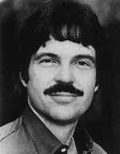
Personal computing
1970s – Papert's LOGO language for simple graphics programming by children
A system is more powerful as it becomes easier to user
Future of computing in small, powerful machines dedicated to the individual
Kay at Xerox PARC – the Dynabook as the ultimate personal computer
Alan Kay
Dynabook - Notebook sized computer loaded with multimedia and can store everything

Slide 47
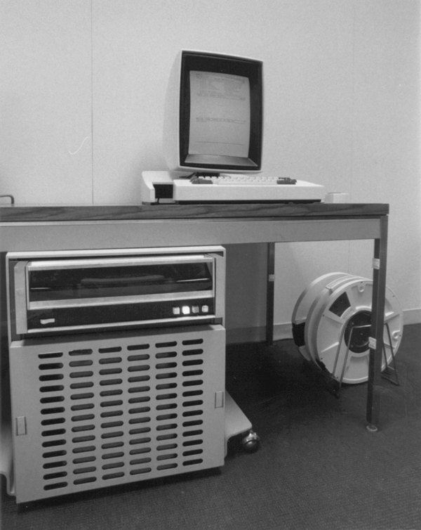
Window systems and the WIMP interface
humans can pursue more than one task at a time
windows used for dialogue partitioning, to “change the topic”
Xerox PARC - mid 1970’s
  Alto
    local processor, bitmap
    display, mouse
    Precursor to modern GUI,
    windows, menus, scrollbars
    LAN - Ethernet

Slide 48
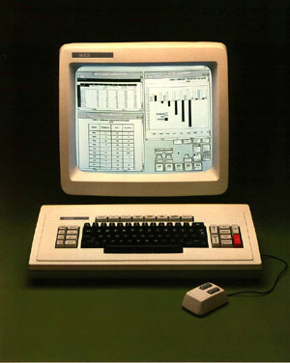
Window systems and the WIMP interface
1981 – Xerox Star first commercial windowing system
windows, icons, menus and pointers now familiar interaction mechanisms

Slide 49
Metaphor
relating computing to other real-world activity is effective teaching technique
  LOGO's turtle dragging its tail
  file management on an office desktop
  word processing as typing
  financial analysis on spreadsheets
  virtual reality – user inside the metaphor
Problems
  some tasks do not fit into a given metaphor
  cultural bias

Slide 50
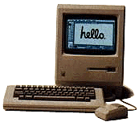
Direct manipulation
1982 – Shneiderman describes appeal of graphically-based interaction
  visibility of objects
  incremental action and rapid feedback
  reversibility encourages exploration
  syntactic correctness of all actions
  replace language with action
1984 – Apple Macintosh
the model-world metaphor
What You See Is What You Get (WYSIWYG)

Slide 51
Language versus Action
actions do not always speak louder than words!
DM – interface replaces underlying system
language paradigm
interface as mediator
interface acts as intelligent agent
programming by example is both action and language

Slide 52
Hypertext
1945 – Vannevar Bush and the memex
key to success in managing explosion of information
mid 1960s – Nelson describes hypertext as non-linear browsing structure
hypermedia and multimedia
Nelson's Xanadu project still a dream today

Slide 53
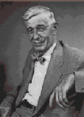
Innovator: Vannevar Bush
“As We May Think” - 1945 Atlantic Monthly
  “…publication has been extended far beyond our
  present ability to make real use of the record.”
Postulated Memex device
  Stores all records/articles/communications
  Items retrieved by indexing, keywords, cross
  references (now called hyperlinks)
  (Envisioned as microfilm, not computer)
Interactive and nonlinear components are key
http://www.theatlantic.com/unbound/flashbks/computer/bushf.htm

Slide 54
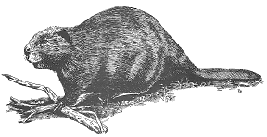
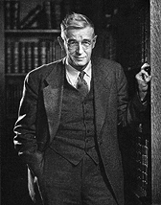
More About Vannevar Bush
Name rhymes with "Beaver"
Faculty member MIT
Coordinated WWII effort with 6000 US scientists
Social contract for science
  federal government funds universities
  universities do basic research
  research helps economy & national defense
Notes:
Picture of Bush from http://www-eecs.mit.edu/AY95-96/events/bush/

Slide 55
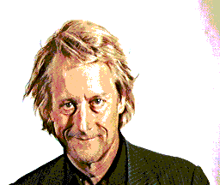
Innovator: Ted Nelson
Computers can help people, not just business
Coined term
“hypertext”

Slide 56
Multimodality
a mode is a human communication channel
emphasis on simultaneous use of multiple channels for input and output

Slide 57
Computer Supported Cooperative Work (CSCW)
CSCW removes bias of single user / single computer system
Can no longer neglect the social aspects
Electronic mail is most prominent success

Slide 58
The World Wide Web
Hypertext, as originally realized, was a closed system
Simple, universal protocols (e.g. HTTP) and mark-up languages (e.g. HTML) made publishing and accessing easy
Critical mass of users lead to a complete transformation of our information economy.

Slide 59
Agent-based Interfaces
Original interfaces
  Commands given to computer
  Language-based
Direct Manipulation/WIMP
  Commands performed on “world” representation
  Action based
Agents - return to language by instilling proactivity and “intelligence” in command processor
  Avatars, natural language processing

Slide 60
Examples of new paradigms
Ubiquitous computing (mother of them all)
Pervasive computing
Wearable computing
Tangible bits, augmented reality
Attentive environments
Transparent computing
  and many more….

Slide 61
Ubiquitous Computing
The most profound technologies are those that disappear.”
Mark Weiser, 1991
Late 1980’s: computer was very apparent
How to make it disappear?
  Shrink and embed/distribute it in the physical world
  Design interactions that don’t demand our intention

Slide 62
Ubiquitous Computing
“The most profound technologies are those that disappear. They weave themselves into the fabric of everyday life until they are indistinguishable from it.”
Mark Weiser, 1991
Late 1980’s: computer was very apparent
How to make it disappear?
  Shrink and embed/distribute it in the physical world
  Design interactions that don’t demand our intention
Aka pervasive computing

Slide 63

Innovator: Mark Weiser
Introduced notion of Ubiquitous Computing and Calm Technology
  It’s everywhere, but recedes quietly into background
CTO of Xerox PARC

Slide 64
Sensor-based and Context-aware Interaction
Humans are good at recognizing the “context” of a situation and reacting appropriately
Automatically sensing physical phenomena (e.g., light, temp, location, identity) becoming easier
How can we go from sensed physical measures to interactions that behave as if made “aware” of the surroundings?

Slide 65
Wearables
New interaction paradigms
  Ubiquitous computing (technology embedded in the environment)
    Computers disappear into the environment so you are no longer aware of them and use them without thinking
    Extends human capabilities
  Pervasive computing (seamless integration of technology), e.g., smart devices (designed for particular activity) cell phones, PDAs, fridges
  Wearable computing (or wearables)

Slide 66
Augmented Reality
New interaction paradigms
  Tangible bits, augmented reality, and physical/virtual integration
    Combine digital info with physical objects
      E.g., greeting card with digital animation
  Attentive environments and transparent computing
    Computers attend to user’s needs
      Anticipate what users want to do, e.g., detect where people are looking and decide what to display (GAP store in Minority Report – Tom Cruise)

